Slide 1
UE17CS490B – Capstone Project Phase – 2
Project Progress Review #2
Project Title : Adversarial Password Cracking
Project ID : PW21SE01
Project Guide : Prof. Sushma E
Project Team : 1600_1621
Vinayaka Hegde PES1201701600
S Thejas PES1201701621

Slide 2
Outline
Abstract and Scope of the Project.
Suggestions from Review – 1.
Approach & Design Description.
Project Progress and Demonstration.
Timeline for Pending Tasks.
Conclusion.
References.

Slide 3
Abstract
Train a generative adversarial network using PassGAN to check the robustness of user passwords.
Compare this with other methods like Hashcat, John the ripper.
Evaluate the strength of Adversarial system using zxcvbn.

Slide 4
Scope
The model can be used as a security measure where system administrators can check for easily crackable passwords.
It can find its applications in checking/suggesting password strength.
The model can substitute other password cracking tools since it does not require knowledge of dataset.
Also the samples generated are not limited to a password space.

Slide 5
Suggestions from Review - 1
How is the length of the output password maintained in a fixed range ?
Defined a variable - max_length that indicates the length of the input password to the model after padding.
So, length of password output from the model will also have this fixed length.

Slide 6
Design Approach
We aim to use generative, unsupervised model like GAN to generate more likely password guesses.
The GAN model consists of two networks called Generator and Discriminator.
Generator is a network that is trained to generate passwords by learning the distribution of the input dataset.
Discriminator labels the passwords generated by generator as real passwords or generated passwords.

Slide 7
Design Approach
Model is said to be trained when the discriminator is unable to label the password as real password or generated password.
After training, discriminator is removed and we use generator to generate a password dataset that can be used to crack passwords.
Also, discriminator can be used to evaluate the strength of a given input password.

Slide 8
Design Approach
Autoencoders can be used instead of GAN to generate passwords since they are generative models and also unsupervised
Supervised models (models that use labels to classify passwords) can be used instead of GAN.

Slide 9
Design Constraints, Assumptions & Dependencies
The assumptions made :
● The training dataset quality is good and volume is high
● Fast cpu/gpu is available to train faster
Dependencies :
● The model uses some of the tensorflow and keras inbuilt libraries for
implementation.
Constraints :
● The performance of the model is constrained by the amount and quality of
the dataset being used to train the model.

Slide 10
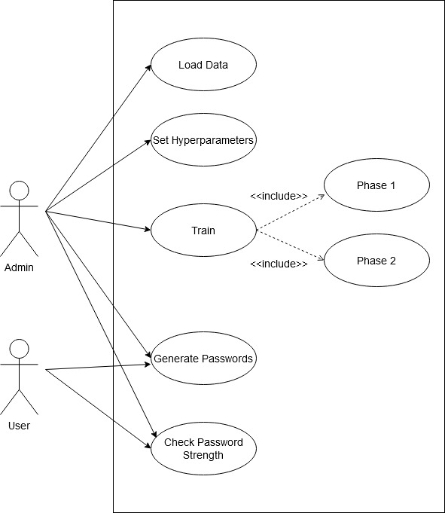
Design Description - User case Diagram

Slide 11
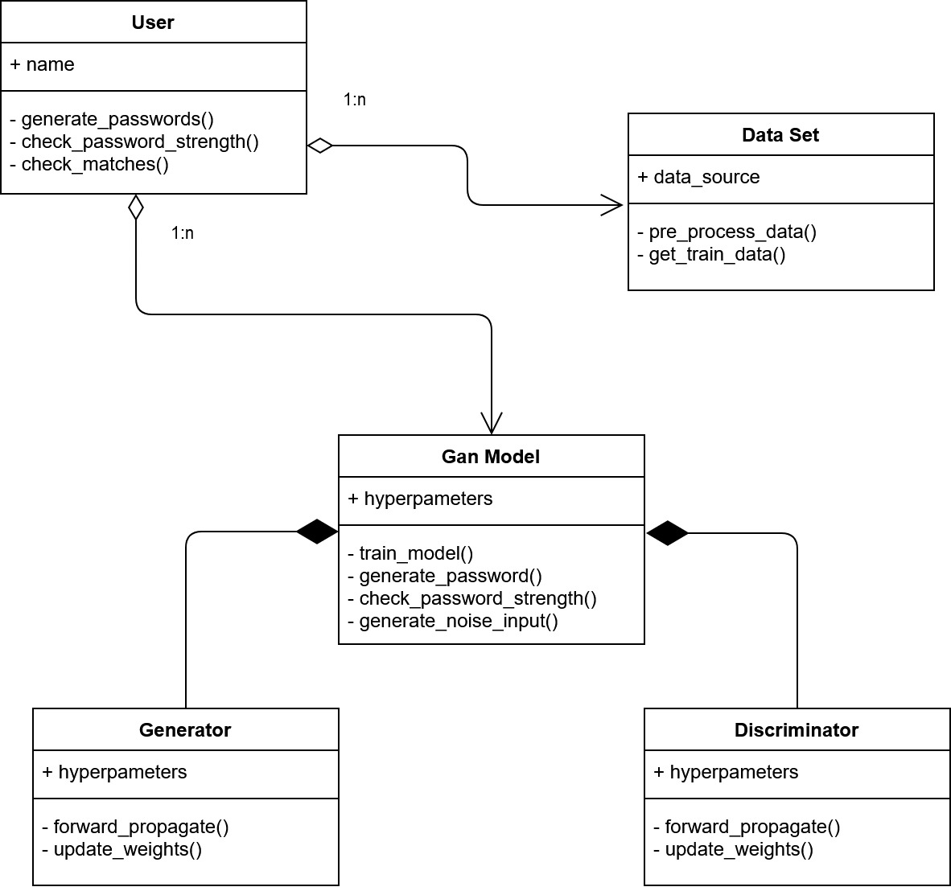
Design Description - Master class diagram

Slide 12
Project Progress So far
What is the project progress so far?
Literature Survey
Project and System Requirements Specification
Design Document
Data Preprocessing
Implementation of the Generator Model
Implementation of the Discriminator Model
Approximate percentage completion of the project - 60% - 70%

Slide 13
Timeline – Update on Pending Tasks
Integration of Generator and Discriminator Models - March 1st Week
Compare the results of GAN with HashCat - March 2nd Week
Design a UI and a password checking tool - By end of March

Slide 14
References
[1] Suman Nepal, Isaac Kontomah, Ini Oguntola, Daniel Wang Department of Electrical Engineering and Computer Science, MIT Cambridge, ‘Adversarial Password Cracking ’
[2] Annie. Chen, ‘Presenting New Dangers: A Deep Learning Approach to Password Cracking’, 2018.
[3] Briland Hitaj, Paolo Gasti, Giuseppe Ateniese, and Fernando PérezCruz. 2018. PassGAN: A Deep Learning Approach for Password Guessing.
[4] Laxmi Ahuja , Vernit Garg , Amity University, ‘Password Guessing Using Deep Learning ’
[5] Generating Optimized Guessing Candidates toward Better Password Cracking from Multi-Dictionaries , Korea University, Seoul 02841, Korea , 2020
[6] Survey Paper on Applications of Generative Adversarial Networks in the Field of Social Media - Ananya Malik Dwarkadas J. Sanghvi College of Engineering Mumbai, Maharashtra

Slide 15
Thank You

